Slide 1
Chapter 2

Slide 2
Major Components of Economics
Scarcity- not enough resources to satisfy peoples wants and needs
Types of Resources- inputs used to make outputs
Wants and Needs

Slide 3
Scarcity vs Shortage
Scarcity drives the study of Economics and how society allocates resoucrces.
Always exist
Shortages
After a natural disaster
Temporary

Slide 4
Factors of Production
Used to produce good and services
Natural Resources
Human Resources
Manufactured Resources
Entrepreneurship

Slide 5
Natural Resources
Land
Mineral Deposits
Water
Forests

Slide 6
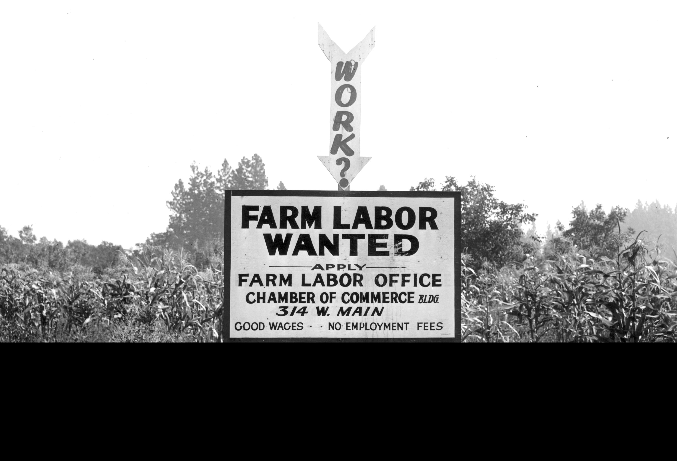
Human Resources
Laborers
Managers
Services
Wages

Slide 7
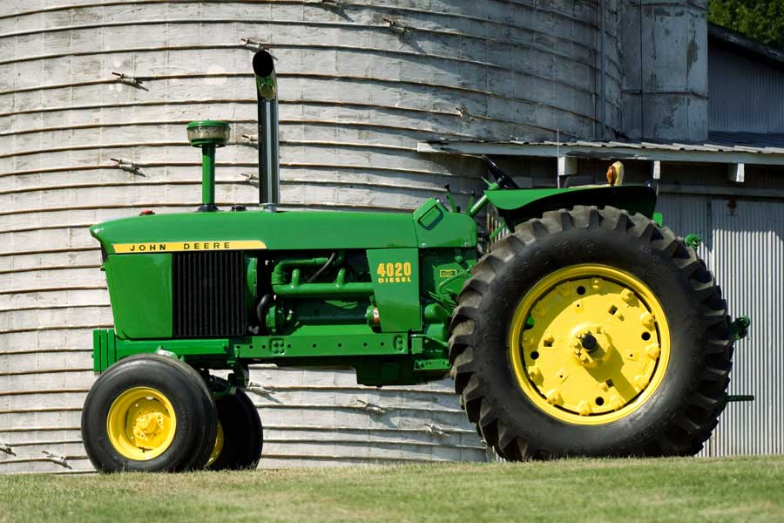
Manufactured Resources
Capital
Machines
Equipment
Structures

Slide 8
Entrepreneurship
Management
New business
New products
New technology
Initiative
Risk
Profit

Slide 9
Wants vs Needs
Needs
Wants
Critical
Food
Clothing
Shelter
Equipment
Insurance
Education
Not Critical
Cab Tractor
Blue Tooth
I Phone
Brand new car
Longhorn Steakhouse
American Eagle
Mansion

Slide 10
Three Basic economic Questions
What goods should be produced and how much of each?
How should these goods be produced?
Who should get what and how much?

Slide 11
What and how much?
Market economy
Consumer choice tells the retailer and manufacturer what to produce

Slide 12
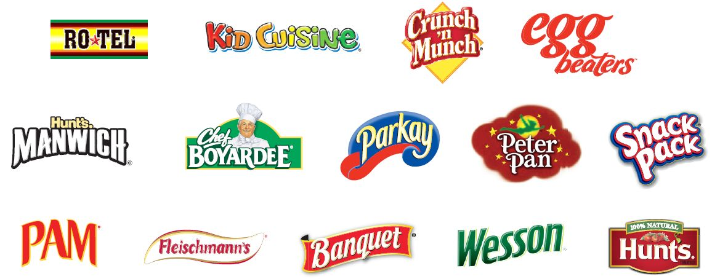
How to Produce
$$$$$$$ talks
Agribusiness firms
Cargill, Nestle, Monsanto, ConAgra, ADM

Slide 13
Who gets it?
$$$$
Needs
Wants

Slide 14
Example
What kind of pie do you like?
Apple, Cherry, Rhubarb, Chocolate
9” round or 9” X 9” Square
Only 6 pies can be made
Who wants, needs, can afford the pie?

Slide 15
Economic Systems
Traditional
Capitalism
Fascism
Socialism
Communism
Mixed

Slide 16
Traditional
Based on traditions
Customs
Religion
Generationally
Agriculture
Barter
Asia
Africa
Middle East
Latin America

Slide 17
Capitalism
Free reign
Few legal controls
Self-regulating
Market determines
Prices
Assign resources
Distribute income
Indicates the value of resources and goods
Ownership private
Free markets
Competition

Slide 18
Socialism
Public ownership of productive resources
Government directs all decisions
Mutual benefit
One employer
Eliminated competition

Slide 19
Facism
Owned by individuals
Government preferences
Political
Denies freedom
Labor
Employers
Consumers

Slide 20
Communism
Totalitarian
Single party or individual
Organized
Economic plan
Centralized
Ability
Need

Slide 21
Mixed
No society will allow complete control by individuals or the government.
Except for traditional, all societies show some mixed

Slide 22
American Economy
Capitalistic
Creation of new business
Hire desired workers
Set price
Socialism
Health care
Subsidies
Crop limitaions
EPA

Slide 23
American Agriculture
Payment in Kind (PIK)
Reduce surpluses
Improve income
Specific products
Supply
Demand

Slide 24
Daddy of Economics?

Slide 25
Economics- History
Modern economics 1776
Adam Smith
An Inquiry Into the Causes of the Wealth of Nations
Father of Economics
Laissez-faire
David Ricardo
Land as a resource
Thomas Malthus
Increasing pop to limited food

Slide 26
American Economy
Little or no government control
Freedom of enterprise
Freedom of choice
The right to own private property
Competition

Slide 27
US Government
Private individuals
Originally
Defense
Keep Peace
More Recent
Regulation of business
Provide public services
FDA
FDIC
OSHA
EPA

Slide 28
Freedom
Freedom of Enterprise
Freedom of Choice
Free enterprise system
Own and make decision
Limits
Age limits
Hour restrictions to work
Minimum wages
Freedom to fail
Buyers decide production
Laws to protect buyers
Safety
Label, tags
Appliances
Autos
Utilities

Slide 29
Private Property
Owned by individuals or a group
Not federal or state
Buy what you want
Control use
Keep profit

Slide 30
Macro vs Micro
Macroeconomics
Microeconomics
Macro means large
Study of large scale or nationally
Aggregate
Subsectors
Household
Business
Government
7 key concepts
Micro means small
Small scale
Individual markets
Individuals
Single firms
Ind government agencies
USDA
6 key concepts

Slide 31
Macro
GDP
Aggregate Supply
Aggregate Demand
Unemployment Rate
Inflation and deflation
Monetray policy
Fiscal Policy
Inflation- rise in general level of prices measured against a baseline of purchasing power
Deflation- decrease in the general price level over a period of time

Slide 32
Micro
Market and Prices
Supply and Demand
Competition and Market Structure
Income Distribution
Business Failures
Role Government
Supply- different quantities of a resource, good, service that will be offered to consumers at various prices during a given time
Demand- economic want back by purchasing power, expressing different amounts of a product buyers are willing and able to buy at possible prices

Slide 33
Positive vs Normative
Positive
Normative
Objective statements
Facts
Questions
Actuality
What is, what was, what will probably happen
Cost-benefit analysis
Subjective
Opinions
What ought to be
Political campaigns

Slide 34
Other Terms
Fallacy of Composition – that which is true in an individual situation is not necessarily true in the aggregate.

Slide 35
Monetary Policy
Monetary policy is a tool used by the central bank to manage money supply in the economy in order to achieve a desirable growth of the economy. The central bank controls the money supply be increasing and decreasing the cost of money otherwise known as the interest rate.

Slide 36
Forms of Monetary Policy
Expansionary
Contractionary
Policy makers increase the money supply in the system by lowering interest rates. This is done mainly to boost economic growth and decrease the level of unemployment.
The cost of money is made higher by increasing the rate of interest, which in turn helps in reducing the money supply in the system and combat inflation. Thus, while expansionary policy is followed to boost economic growth, contractionary policy is adopted to deal with an overheated economy.

Slide 37
Objectives
Economic Growth – Increase in capital formation
Exchange Stability – Stability of balance of payments
Full Employment – Increase production
Price Stability – to eradicate inflation or deflation
Credit Control – increase and decrease interest rates
Reduction in economic inequalities – distribution of income and wealth

Slide 38
Instruments of Monetary Policy
Supply of Money
Cost of Money
Availability of Money
Rates of Interest
Cash Reserve Requirements
Open Market Operations
Margin Requirements for Loans
Rationing

Slide 39
Fiscal Policy
Used by the governments to influence the level of aggregate demand in the economy. Fiscal policy is used to achieve economic objectives of price stability, full employment and economic growth.

Slide 40
Objectives of Fiscal Policy
Reduce Unemployment – increases government expenditures and/or reducing taxes
Increase Growth Rate of Gross Domestic Product (GDP) increase the rate of capital formation.
Reduce Economic Inequality -

Slide 41
Instruments of Fiscal Policy
Spending by the Federal Government
Taxation by the Federal Government
Deficit Financing
Investment in Private Sector through Government programs

Slide 42
How is Monetary Policy different from Fiscal Policy?
Monetary Policy uses the supply of money and interest rates to control the size of the economy, employment and prices.
Fiscal Policy uses the government’s power to tax and spend to control the size of the economy, employment and prices.
These two policies are enacted by two independent bodies as well and can work at odds with each other.

Slide 43
Competition vs Competitive Business Perspective
Competition
Competitive Business Perspective
Price
Supply
Resources used
Marketing
Hiring
Firing

Slide 44
Agricultural Economics
Economics=basic science
Ag Economics=applied science
Did not begin in a specific
Year
Publication
Began as farm economics
Now total ag industry
Specialty Areas
Production (Farm Management)
Agricultural Finance
Rural Development
Price Analysis
Agricultural Policy
International Development
Marketing

